Slide 1
Welcome to the FAMU
College of Law!
Signing up for your electronic databases

Slide 2
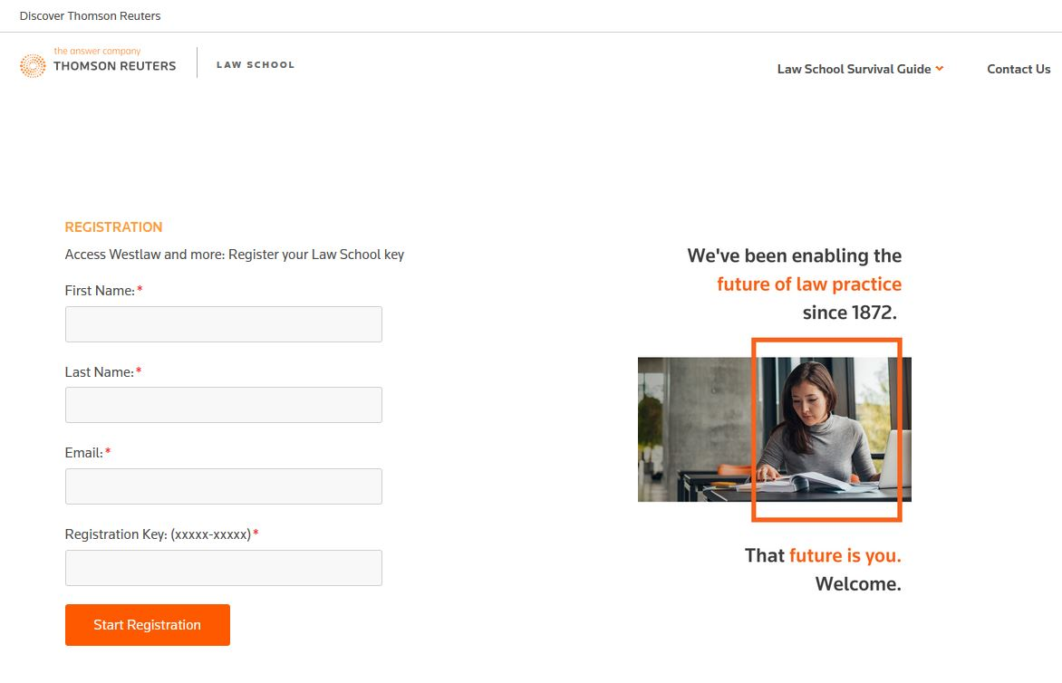
Westlaw

Slide 3
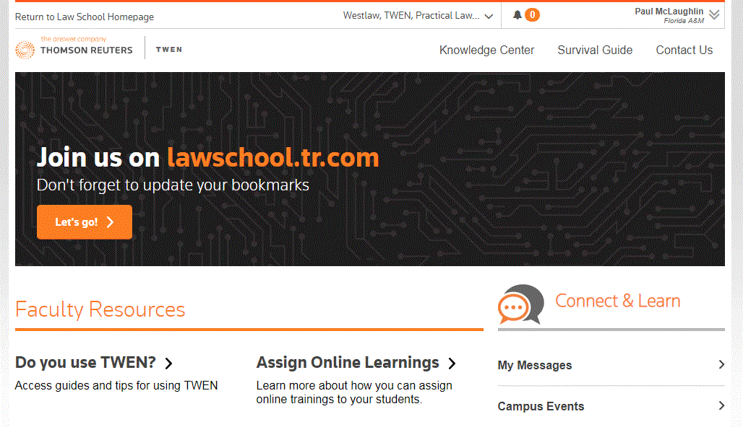
Accessing TWEN and Course Materials

Slide 4
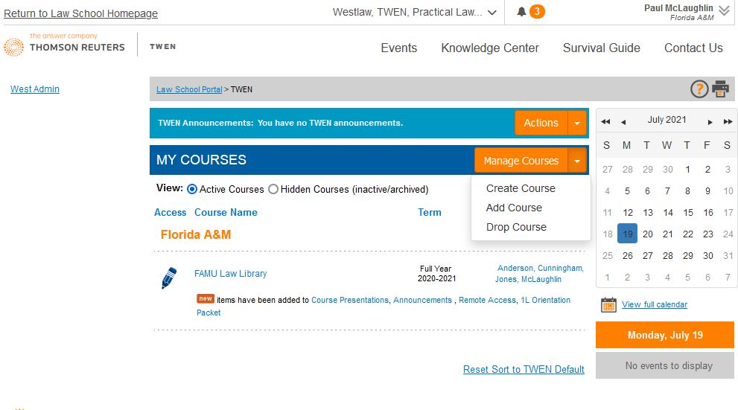
Adding a Course on TWEN

Slide 5
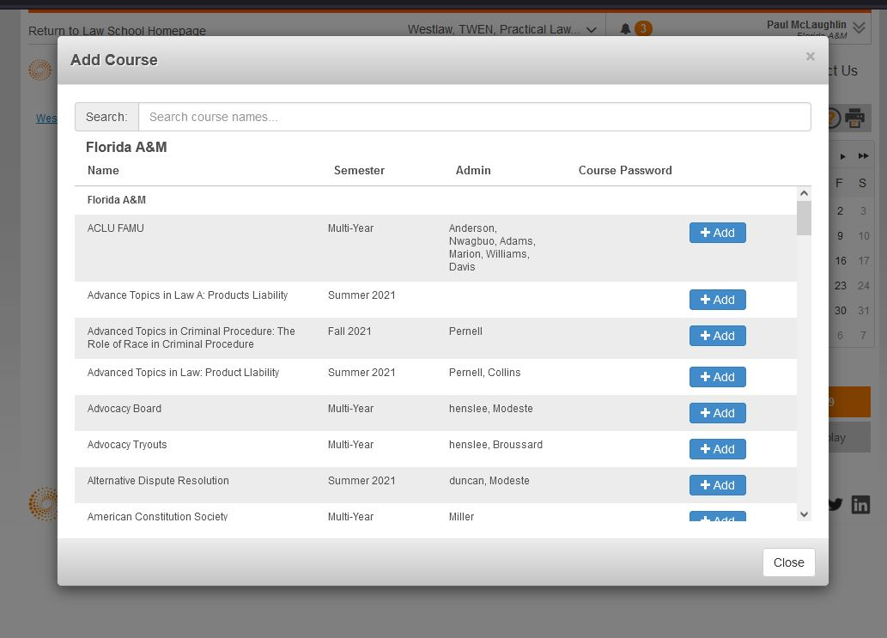
Searching for a Course in TWEN

Slide 6
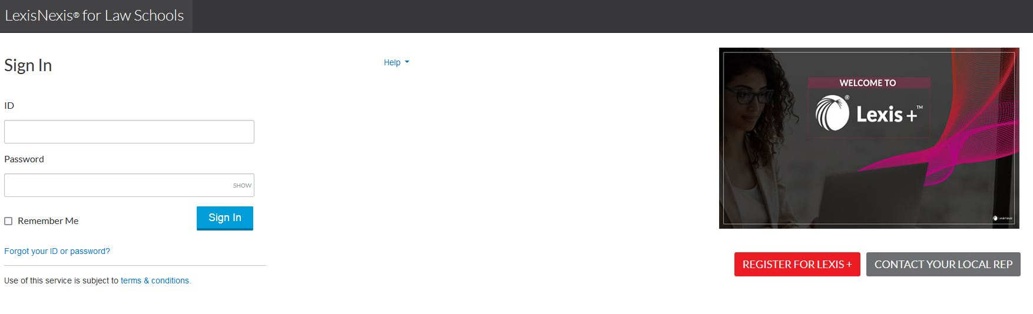
Lexis Advance

Slide 7
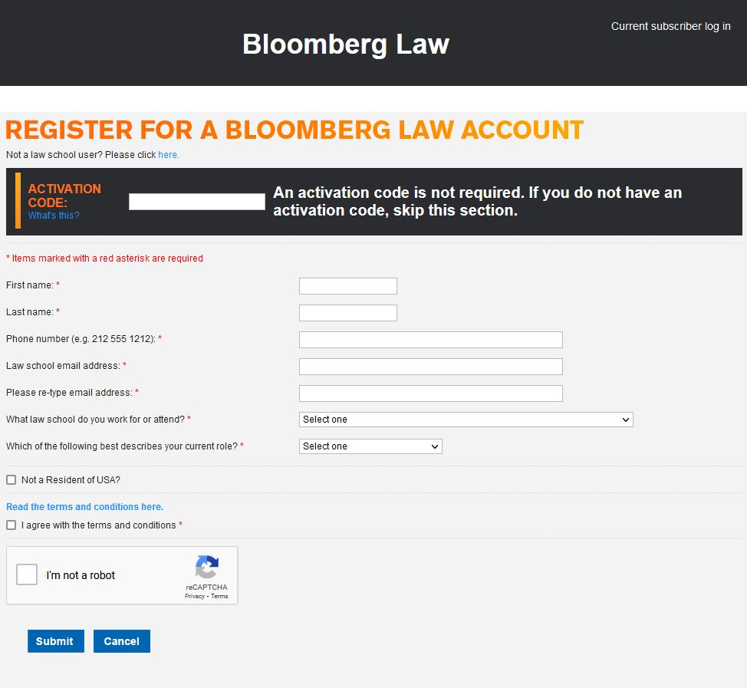
Bloomberg Law

Slide 8
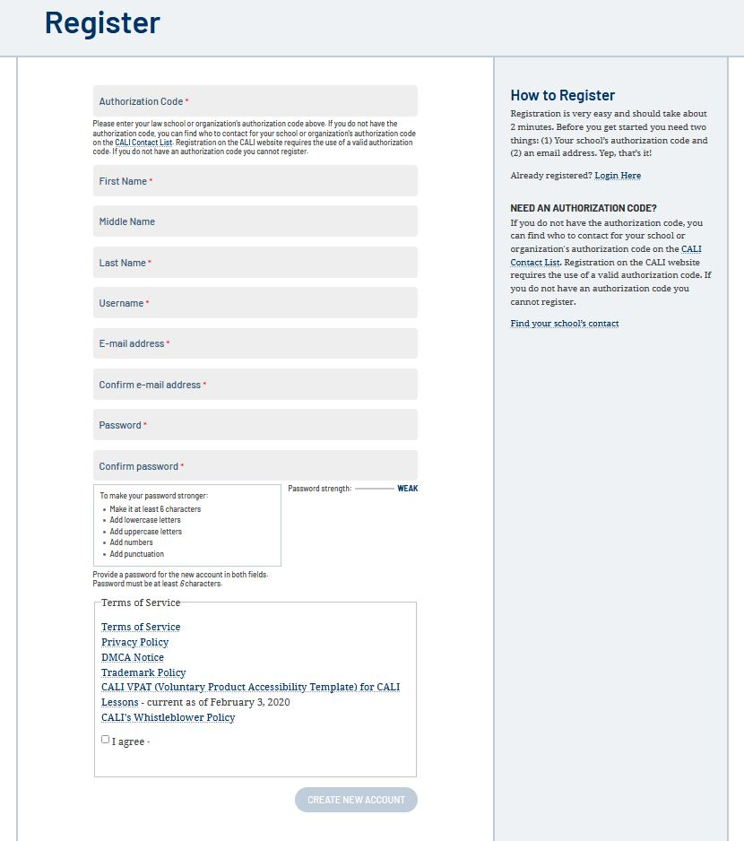
CALI

Slide 9
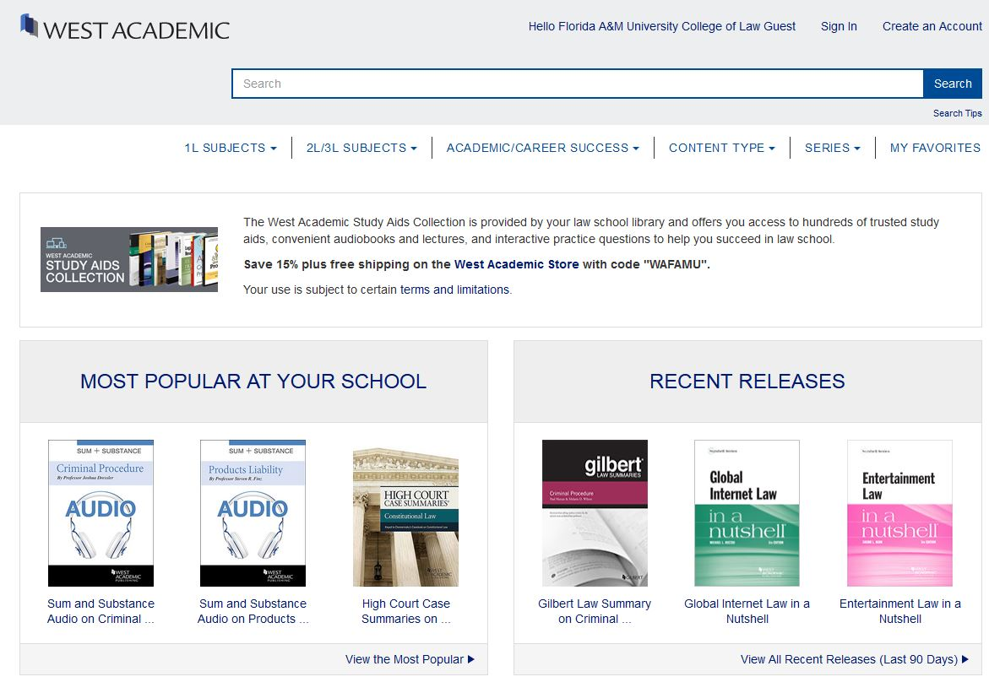
West Academic
*Not associated with your Westlaw account!*

Slide 10
Library Hours
Monday through Friday
  7:00 AM to 9:00 PM
Weekends
  Closed
Reference Services
  7:00 AM to 3:30 PM - Monday through Friday
These times are subject to change. Please check the Law Library’s website for the most current hours of operation.

Slide 11
Law Library
Circulation
  Achara Stone
  Phyllis Allen
  Haydee Fernandez
Reference
  Paul McLaughlin
Technical Services
  Linda Sobey
  Melanie Solon
Director
  Yolanda Patrice Jones

Slide 12
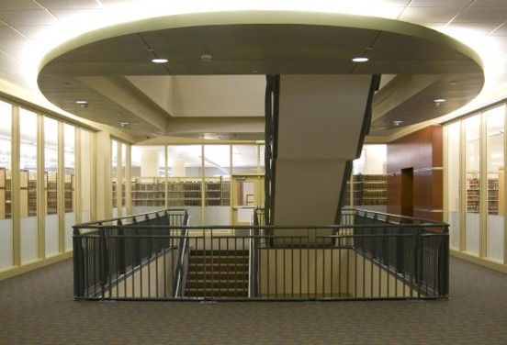
We look forward to seeing you in the library.

